Slide 1
Facial Expression Classification using Deep Learning
Behram Khan
71403-0345804-5
DSAI - Gilgit - Section 4
behramkhan7718@gmail.com
Github:https://github.com/BEHRAAMM/CV_Facial_Expression-Recognition-Project

Slide 2
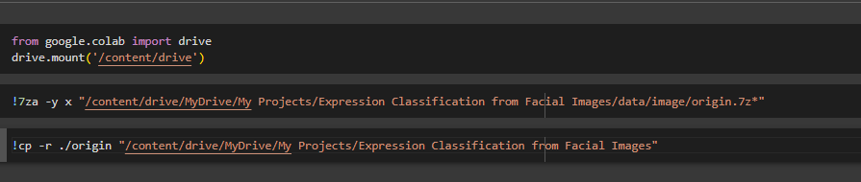
Mount Drive
Extract Files
Upload the data to your drive

Slide 3
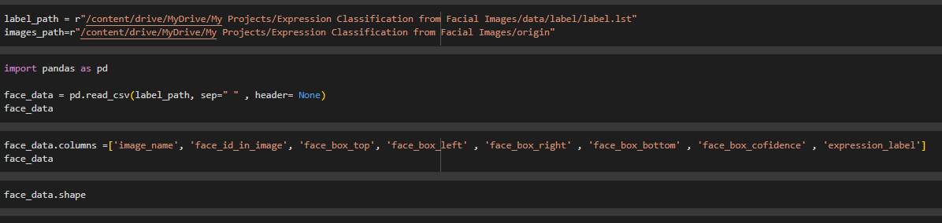
Read file from Drive
Change file to pandas data frame
Assign column names

Slide 4
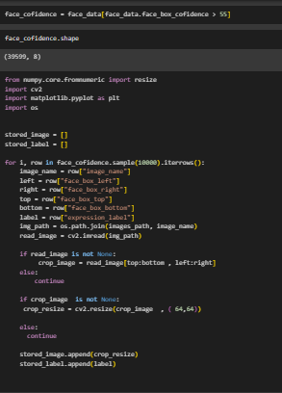
Set a threshold on the base of face confidence
Set to empty array:
stored_image and stored_labe
Iterate data with for loop
Select filename
Combine file name with path
Crop face from image
Resize image
Store image in stored_image
Store label in stored_labe

Slide 5
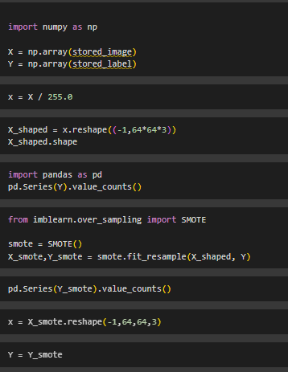
Change list to numpy array
Normalized x
Reshape x
SMOTE for Imbalanced Classification
Reshape X

Slide 6
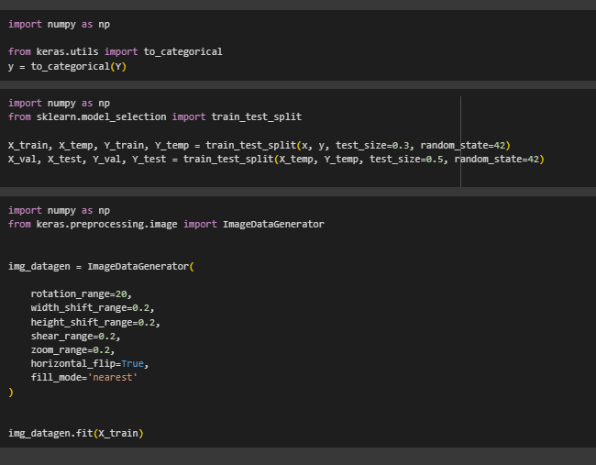
One hot encoding of Y
Split data into train, test and validation
Augmentation of data

Slide 7
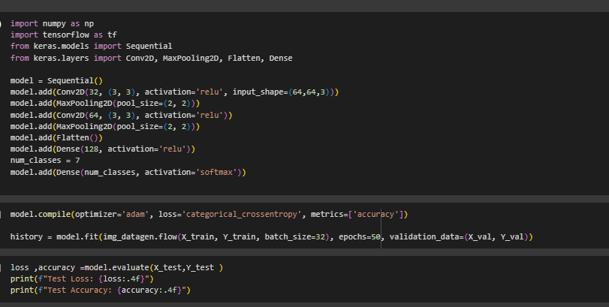
Creating a model
Training a model
Evaluating model

